Slide 1

Overfitting-Underfitting and Regularization
Dr. Nilay Karade
Academic Program Manager

Slide 2
Agenda
Recap
Simple Linear Regression
Multiple Linear Regression
Polynomial Regression
Evaluation metrics
Model overfitting and underfitting
Regularization
Ridge
Lasso
Elastic net

Slide 3
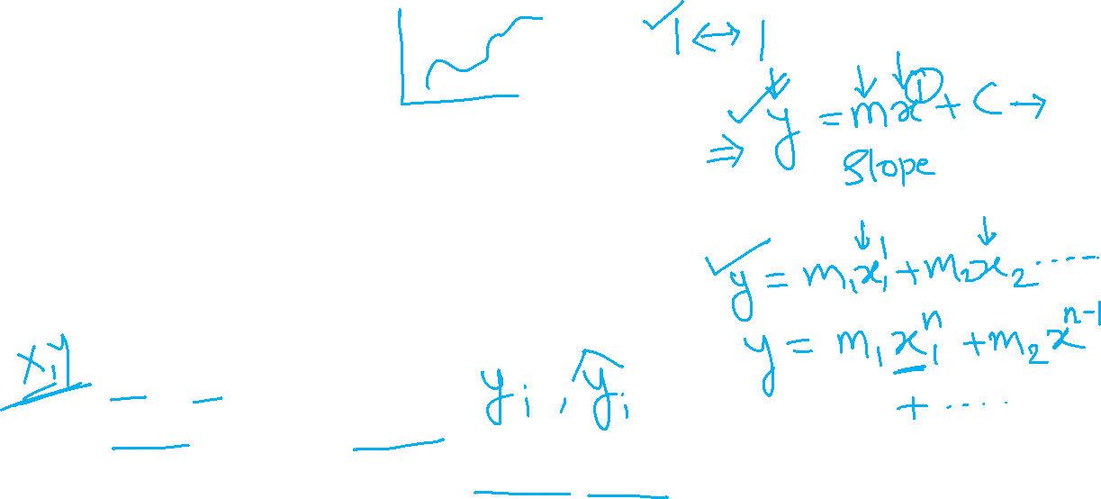
Recap
Equation of line for simple linear regression
What is m?
What is c?
Equation of line for multiple linear regression
Equation of line for polynomial regression
train_test_spilt
X_test -> model -> y_pred
Model evaluation compare y_test, y_pred
MAE,MSE,RMSE,R Square

Slide 4
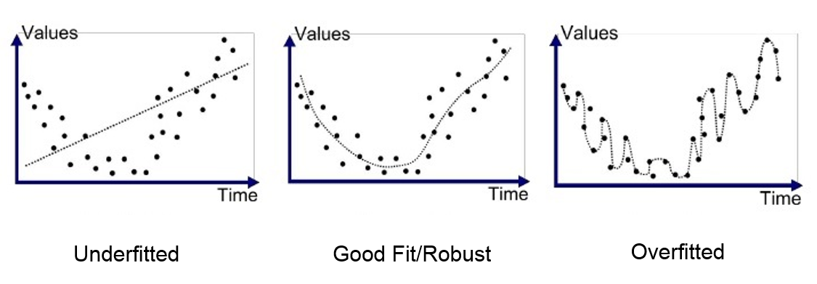
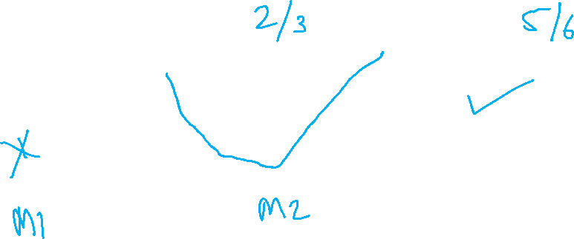
Which one is the best model?
https://medium.com/greyatom/what-is-underfitting-and-overfitting-in-machine-learning-and-how-to-deal-with-it-6803a989c76

Slide 5
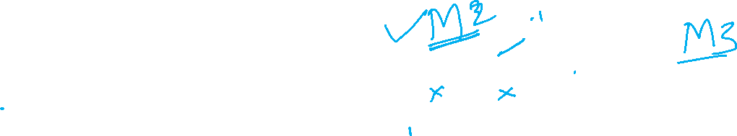
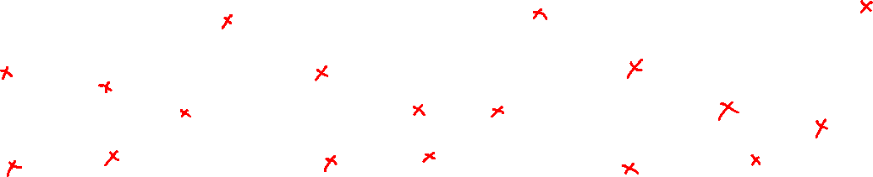
Which one is the best model?
https://medium.com/greyatom/what-is-underfitting-and-overfitting-in-machine-learning-and-how-to-deal-with-it-6803a989c76

Slide 6
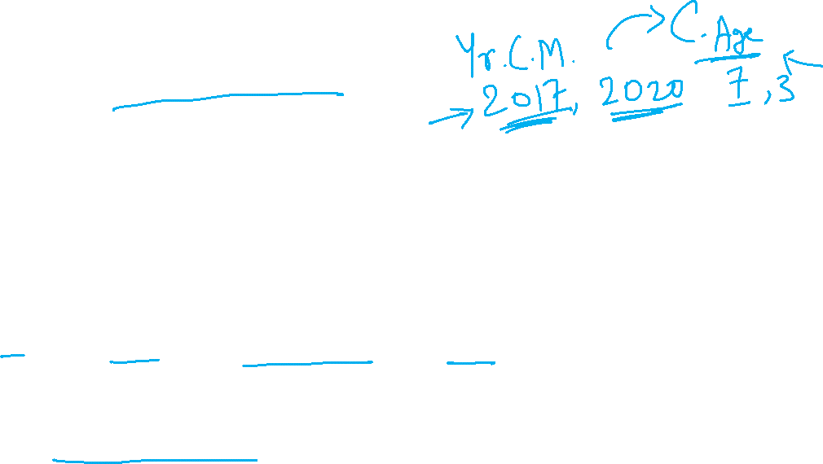
Model underfitting
A machine learning model is said to have underfitting when a model is too simple to capture data complexities.
It represents the inability of the model to learn the training data effectively result in poor performance both on the training and testing data.
In simple terms, an underfit model’s are inaccurate, especially when applied to new, unseen examples. It mainly happens when we uses very simple model with overly simplified assumptions.
Note: The underfitting model has High bias and low variance.
Reasons for Underfitting
The model is too simple, So it may be not capable to represent the complexities in the data.
The input features which is used to train the model is not the adequate representations of underlying factors influencing the target variable.
The size of the training dataset used is not enough.
Techniques to Reduce Underfitting
Increase model complexity.
Increase the number of features, performing feature engineering.
Remove noise from the data.
Increase the number of epochs or increase the duration of training to get better results.
https://www.geeksforgeeks.org/underfitting-and-overfitting-in-machine-learning/

Slide 7
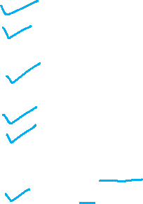
Model overfitting
Overfitting occurs when a model learns not only the underlying patterns in the training data but also the noise and random fluctuations. This results in a model that performs very well on training data but poorly on new, unseen data.
Reasons for Overfitting:
The model is too complex.
Small size of the training data.
Techniques to Reduce Overfitting
Increase the training data can improve the model’s ability to generalize to unseen data and reduce the likelihood of overfitting.
Reduce model complexity.
Early stopping during the training phase (have an eye over the loss over the training period as soon as loss begins to increase stop training).
Ridge Regularization and Lasso Regularization.
Use dropout for neural networks to tackle overfitting.
https://www.geeksforgeeks.org/underfitting-and-overfitting-in-machine-learning/

Slide 8
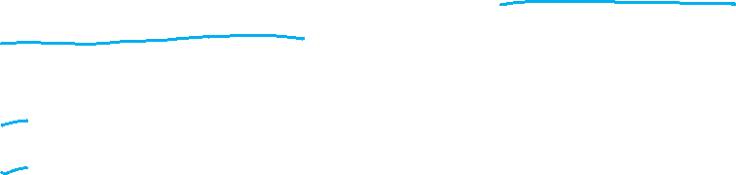
Models based on regularization technique
Regularization techniques used to prevent overfitting by adding a penalty to the loss function.
Regularization techniques based models
Lasso Regression (L1 Regularization)
Ridge Regression (L2 Regularization)
Elastic Net Regression
Recall loss function in Linear Regression

Slide 9
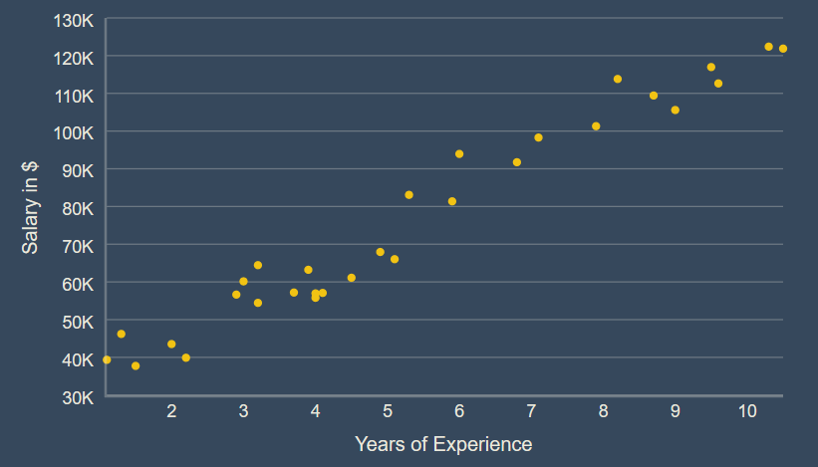
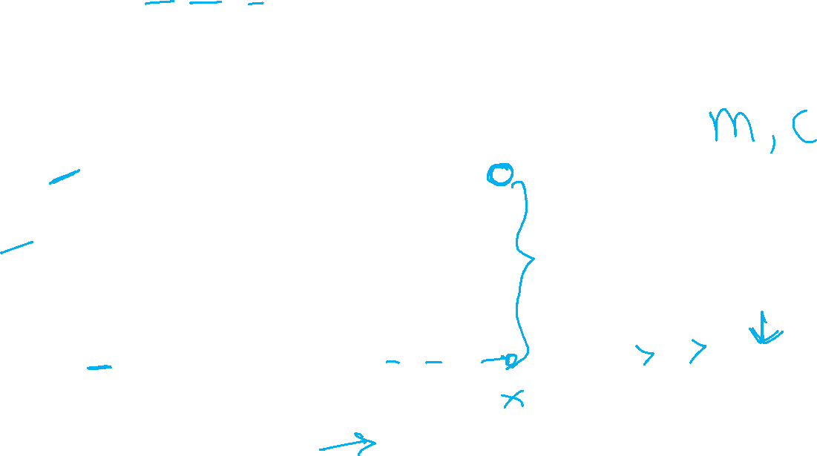
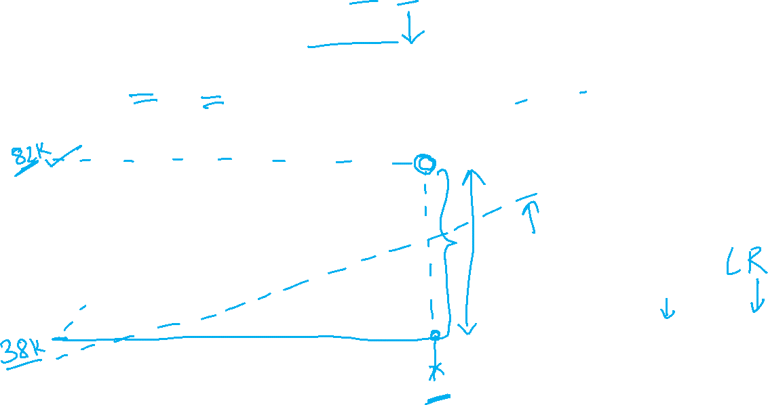
E = E1 + E2 + E3 + … + En
E = ∑Ei
En
y = mx + c
Changing values of m and c
Notes:
9

Slide 10

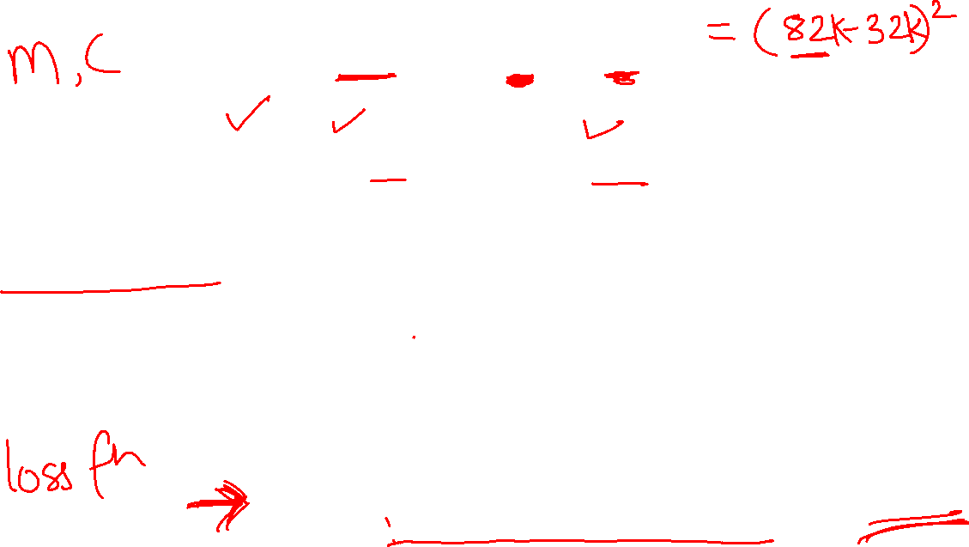











Slide 11








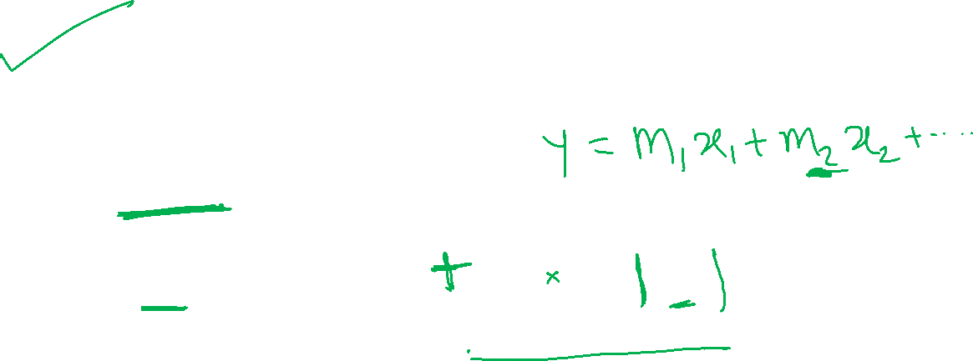















Slide 12


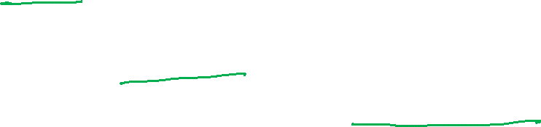




Slide 13
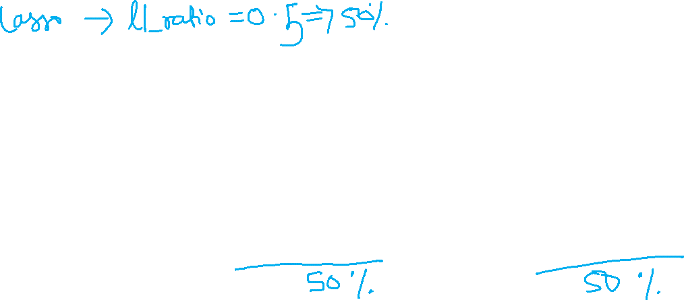



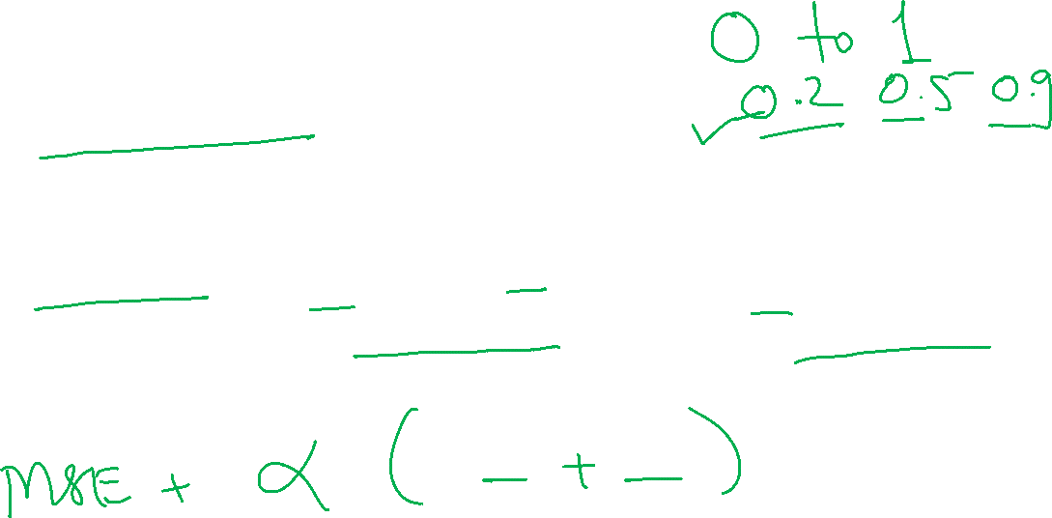

Slide 14
Coding exercise- Implement Lasso, Ridge, Elastic net model for used car price prediction

Slide 15
Code optimization task for all four ML models

Slide 16
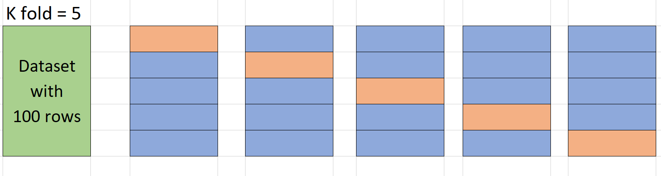
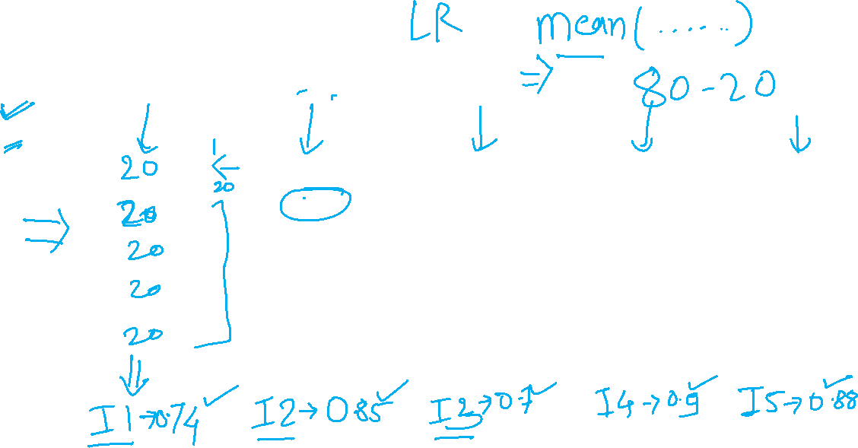
K Fold Cross validation

